Slide 1
DesignXDestiny
Workflow
2021

Slide 2
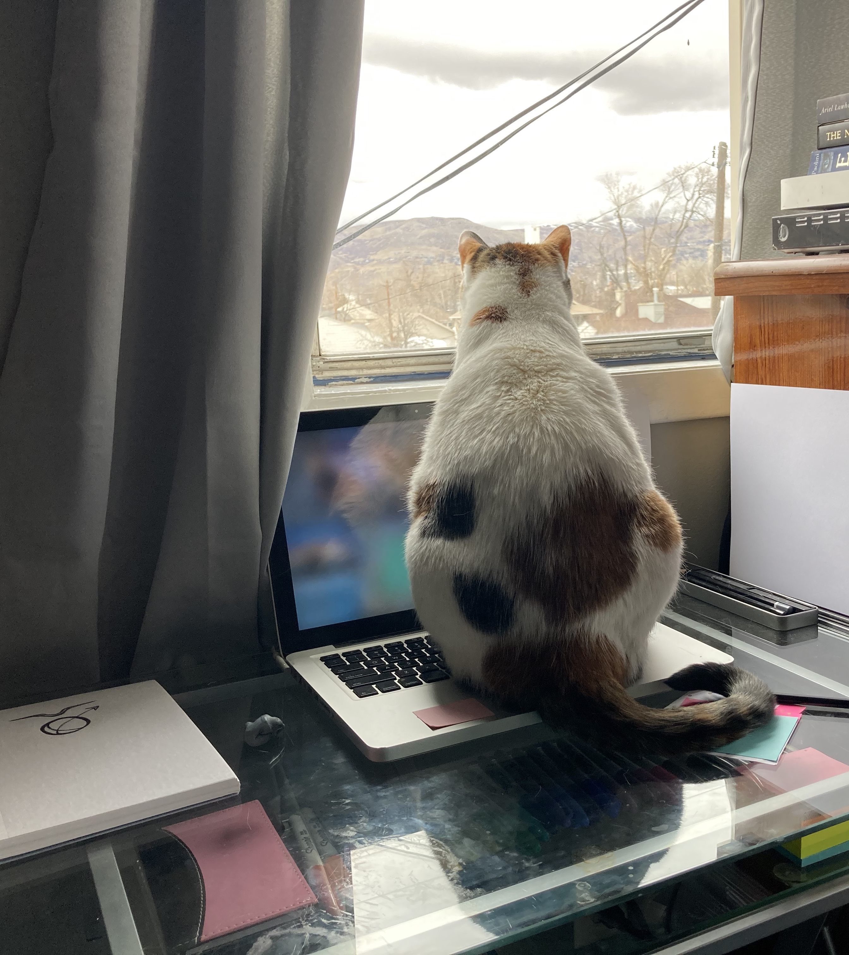
Workflow
Table of Contents
Services Art Design Development
Project Execution Preparation Consultation Design Confirmation Development Deployment

Slide 3
Projects are unique, the process deserves a uniquely tailored experience.
Disclaimer

Slide 4
Services
Art
Graphic Vector Graphics, Digital Illustration, Photo Editing Learned Adobe suite, but Vectornator is free with similar services, and a bit more snappy on my computer
Traditional Portraits, Still Life, Perspective Drawing, Painting, Color, MonoChromatic, multi media, out or water based
Visit my Gallery for examples.

Slide 5
Services
Design
Design Brief
Typography for Website and Page Layout
Branding Package
Vector Logo(s), Icons, symbols
Color Schemes including swatch, #hex / rgb(a) codes for screen or print

Slide 6
Services
Development
Coding for the Web HTML5 / Bones n’ words, CSS3 / Style, JavaScript / interactivity, Markdown / ReadMe Documentation Domain Name / URL, Host / Server where site lives Version Control with GitHub and Git
Art Rendering. . .

Slide 7
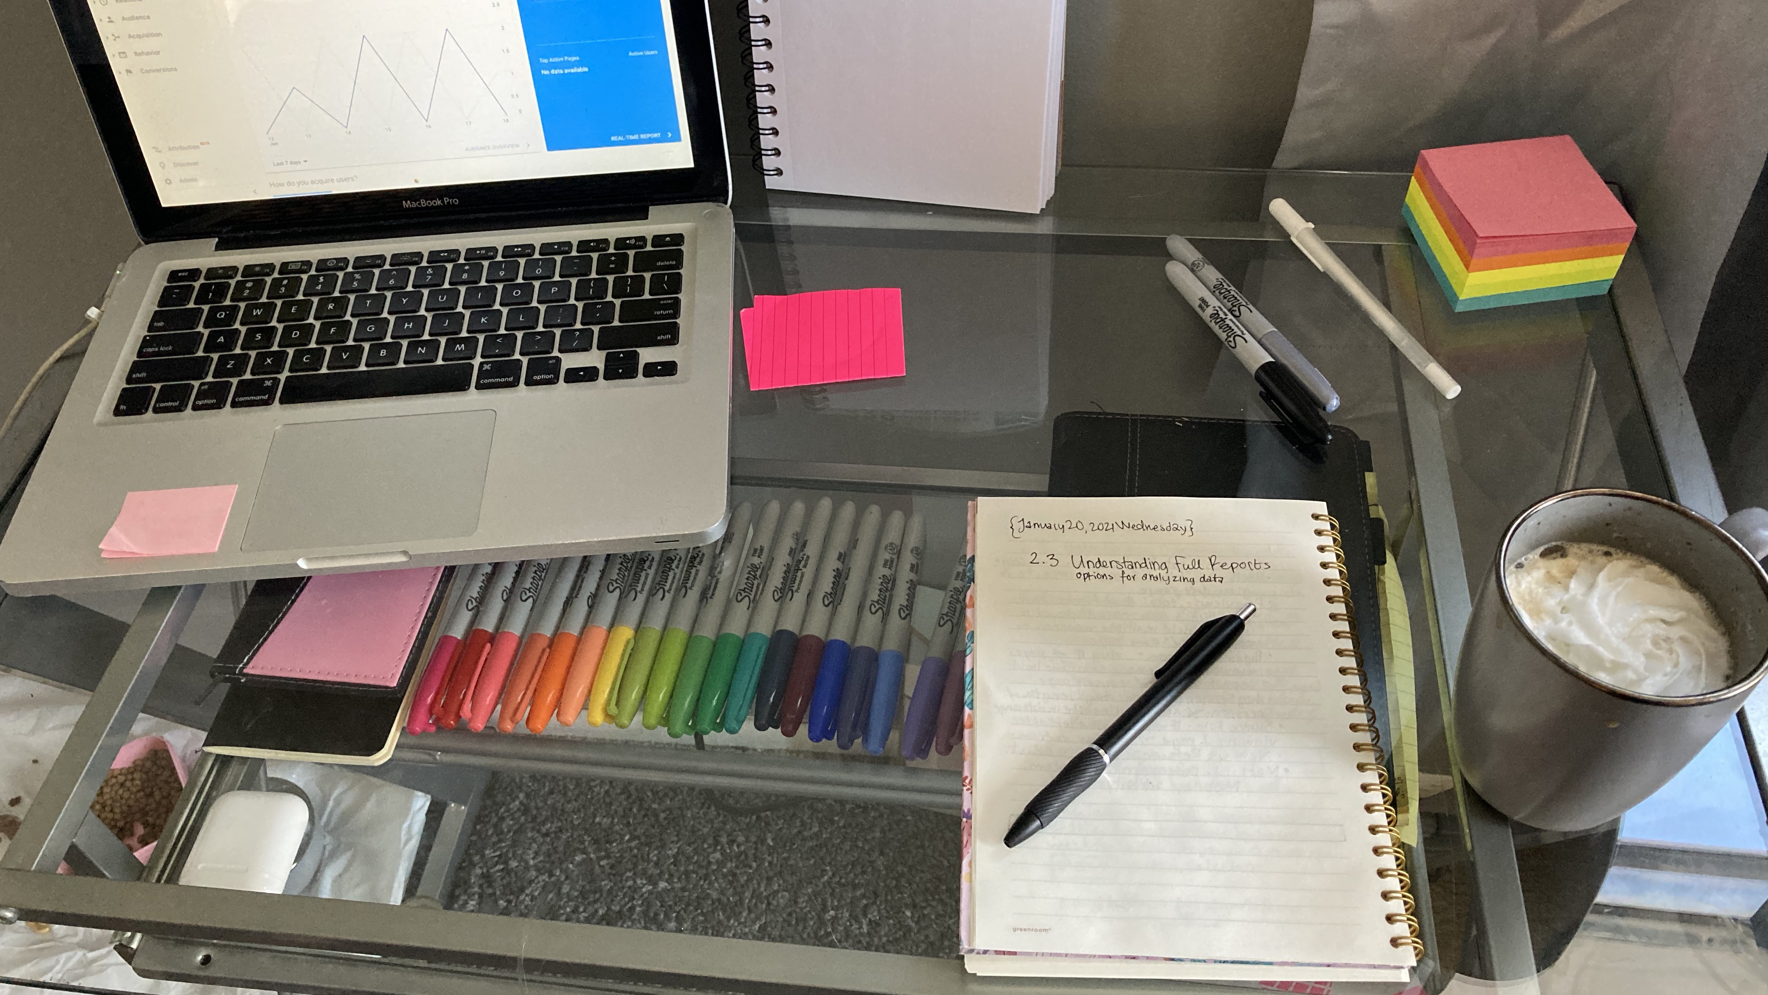

Slide 8
Execution
Preparation
Would my skills be useful in your project? What is your main (business) goal? Let's schedule a time/ place to talk about it.
What existing material do you already have to work with? For example: a website, photos, assets, copy / writing. Including inspiring material.
Looking into your competitors / Market Research.

Slide 9
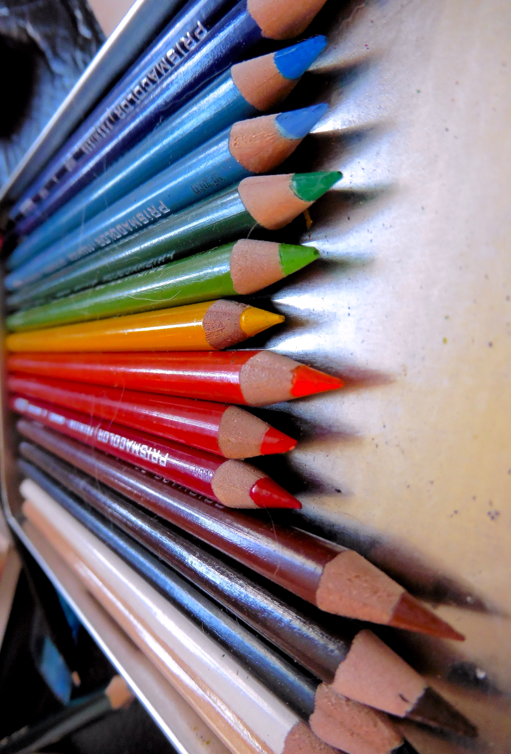
Execution
Consultation
Tell me what your dreams are. What are your Goals and Aspirations? Why are is that what you want to do or see happen? How did you become inspired? Feel as though you can speak to me freely. Tell me which plans and features your heart is set on. Tell me your smaller ideas, even if you're not sure how to make them work. Let it all out.

Slide 10
Execution
Design
The creative stage. +Communication Ever hear, "Measure twice, cut once"? The same concept applies here. I make a preliminary example or prototype, mock-up, thumbnail sketch, whichever is easiest to communicate with for your project. Making sure we are on the same page before continuing to build or create.

Slide 11
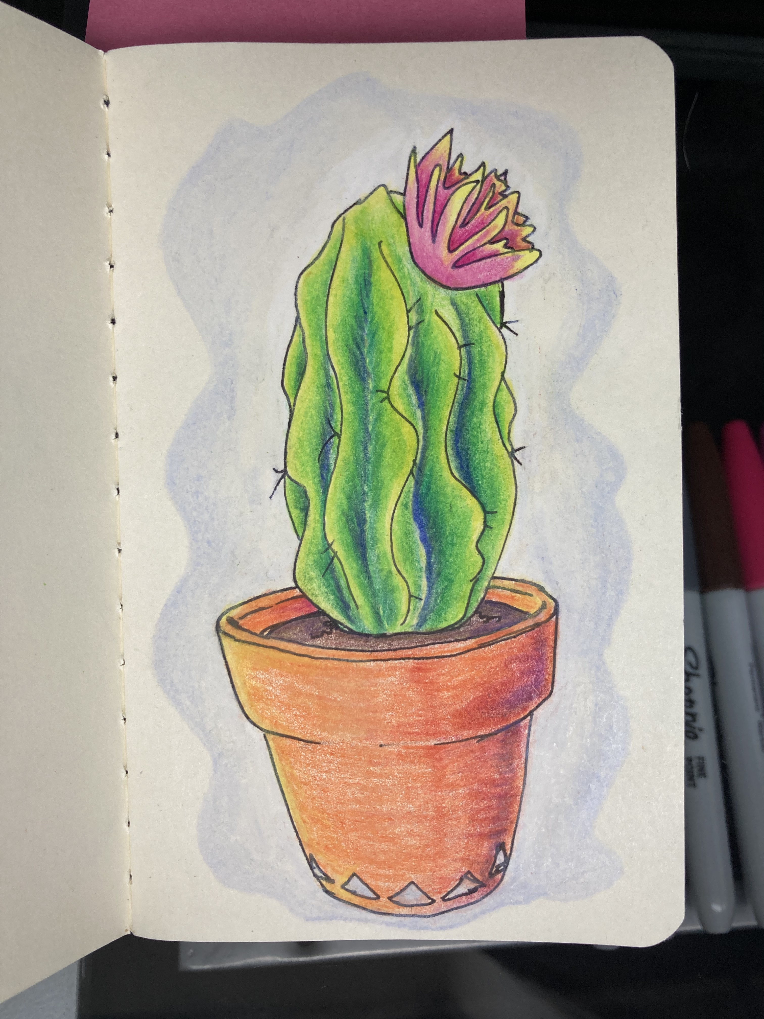
Execution
Confirmation
What is it? We do it again. It is okay to go through a couple of drafts. When the plans look to you like they will produce something you like, we push forward. The more we communicate the more efficient this process becomes. Tell me what you like, and don't like.

Slide 12
Execution
Development
Now lets put all the puzzle pieces together. Following what we talked about, with your vision in mind, pen to paper, key to code, paint to canvas, pixel to print. Test, test, test.

Slide 13
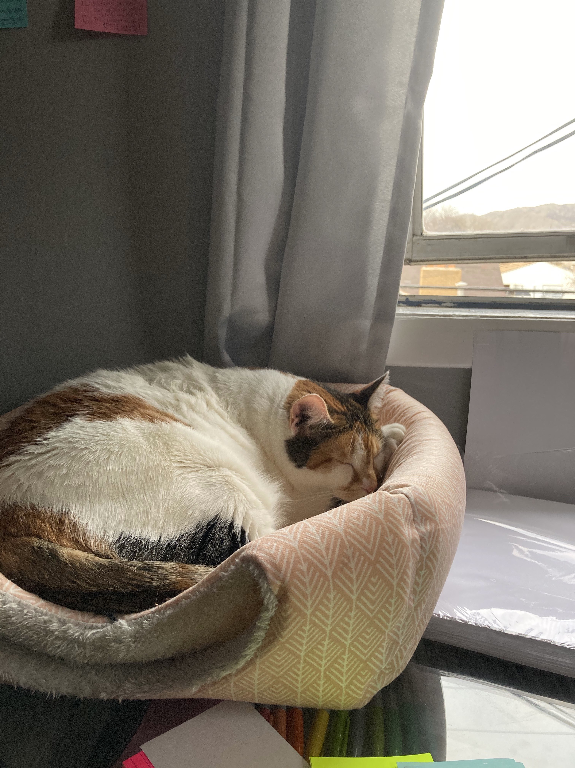
Execution
Deployment
Final Once the final version is approved by you/client, show everyone what we created. Our project is then uploaded, printed, framed and/ or shipped.

Slide 15
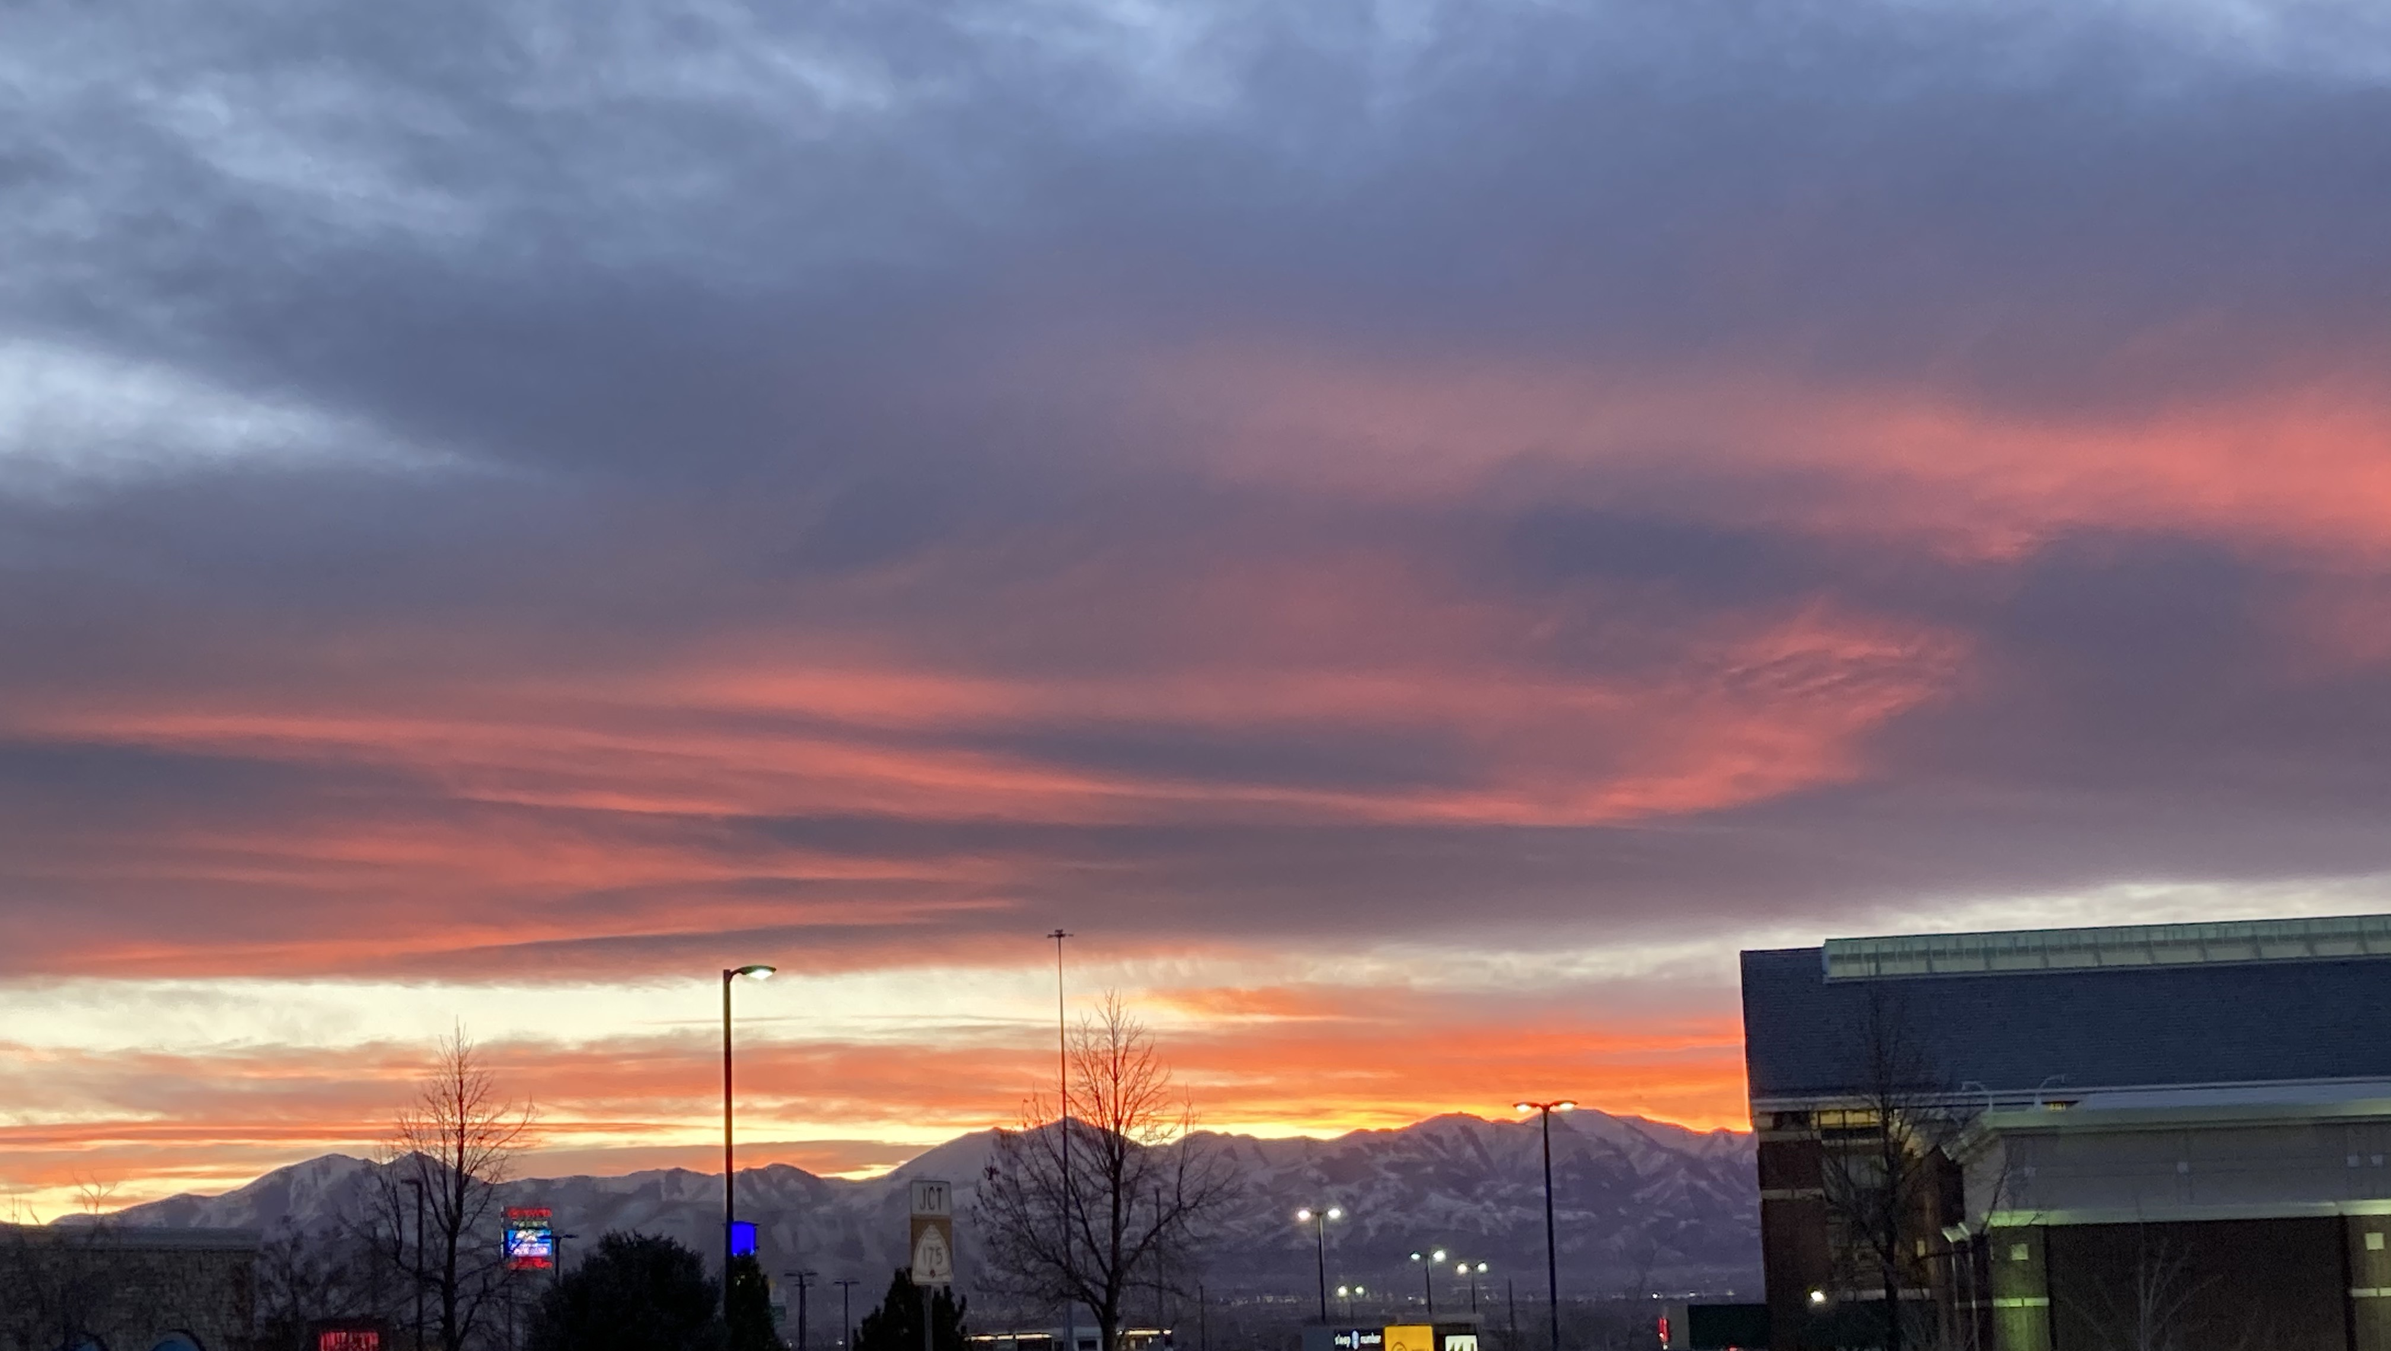

Slide 16
DesignXDestiny
Table of Contents

